Slide 1
Kubernetes
(Using Rancher Desktop and Ingress as the traffic router)

Slide 2
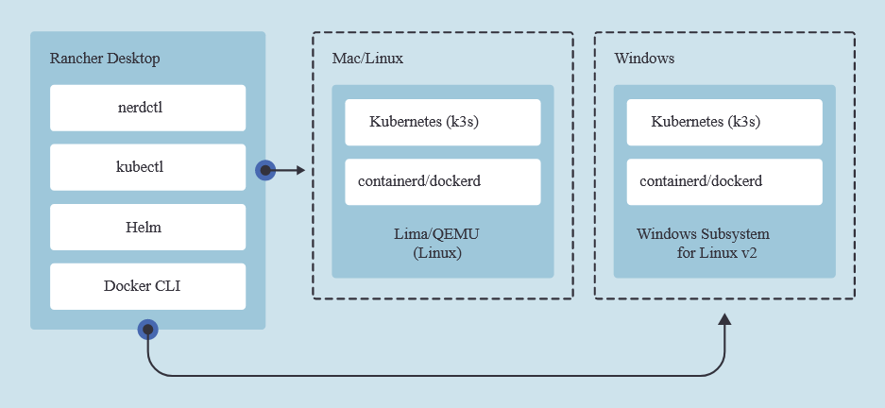
Introduction to Rancher Desktop
Rancher desktop use k3s as Kubernetes distribution.
It has a single node cluster which is used as both master and worker node.
Supports two container runtime – dockerd and containerd (default)
Has a default support for Traefik as traffic management.

Slide 3
Requirement
Let’s assume our team is following microservices architecture and have many apis to be hosted for different services it is providing.
For Example:
Greeting api – for showing a greeting message, every time a user logged in
Product api – for showing all the products in the store
As a platform developer design and develop a solution that will deploy the apis to the Kubernetes with its corresponding services.
For the end user should have one and only entry point and the services should redirect user to the request-path.

Slide 4
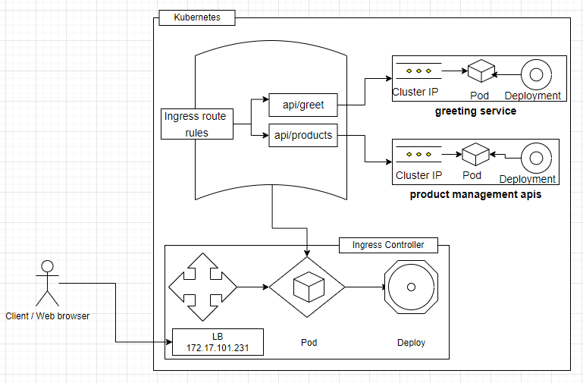
Architecture of Kubernetes deployments with Ingress

Slide 5
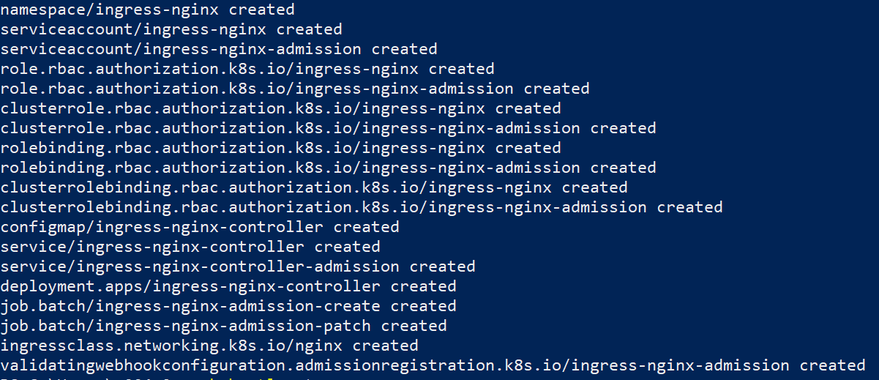
Add / Install Ingress to Kubernetes
Command to Install Ingress kubectl apply -f https://raw.githubusercontent.com/kubernetes/ingress-nginx/controller-v1.3.0/deploy/static/provider/cloud/deploy.yaml

Slide 6
Kube-Manifests Visit

Slide 7
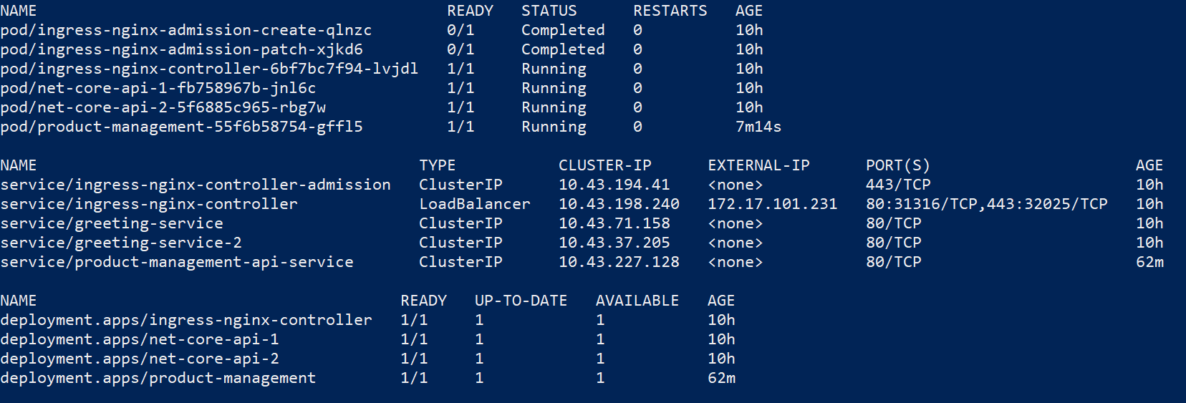
Add Ingress route to services
Creating the deployment & corresponding service: kubectl apply -f "D:\Projects\POCs\Sample.Kubernetes.APIs\Sample.Kubernetes.API2\Kube-Manifests" -n ingress-nginx
Create Ingress Route:
kubectl apply -f "D:\Projects\POCs\ingress.routes.yml" -n ingress-nginx

Slide 8
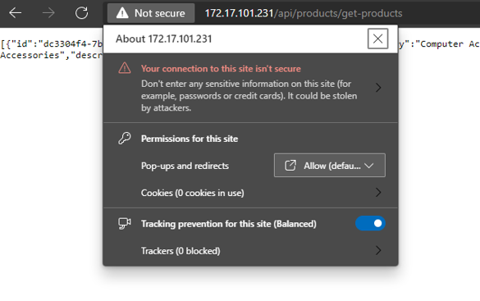
Basic routing implemented.. Is it Secure?
The screenshot on the left side shows that the site we are trying to access is not secure.
That means the data we send to the server from our client can be read by anyone.
Let's make it secure and protect our data communication using TLS.

Slide 9
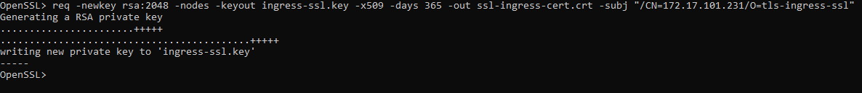
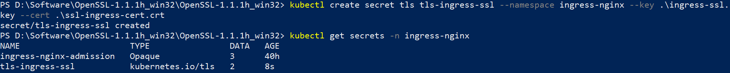
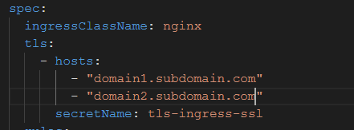
Make the connection secure
Step 1: Download Open SSL
Step 2: Create a self sign cert:
req -newkey rsa:2048 -nodes -keyout ingress-ssl.key -x509 -days 365 -out ssl-ingress-cert.crt -subj "/CN=<host-name>/O=tls-ingress-ssl“
Step 3: Create a secret in the kubectl
Step 4: Configure the host to use your self signed certificate through the cert–secret store

